Slide 1

Roses 101 Part 2
Roses 101 Part 2

Slide 2
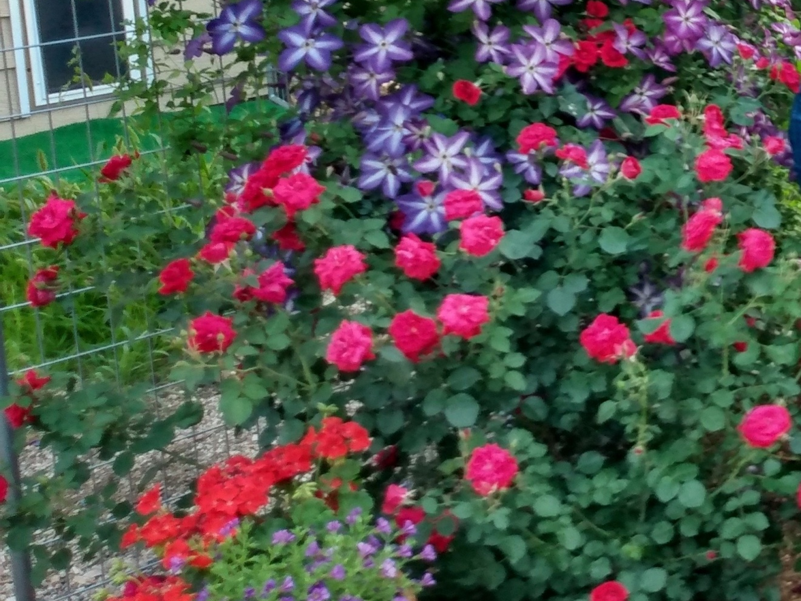
What did you plant?
Any recommended varieties?

Slide 3
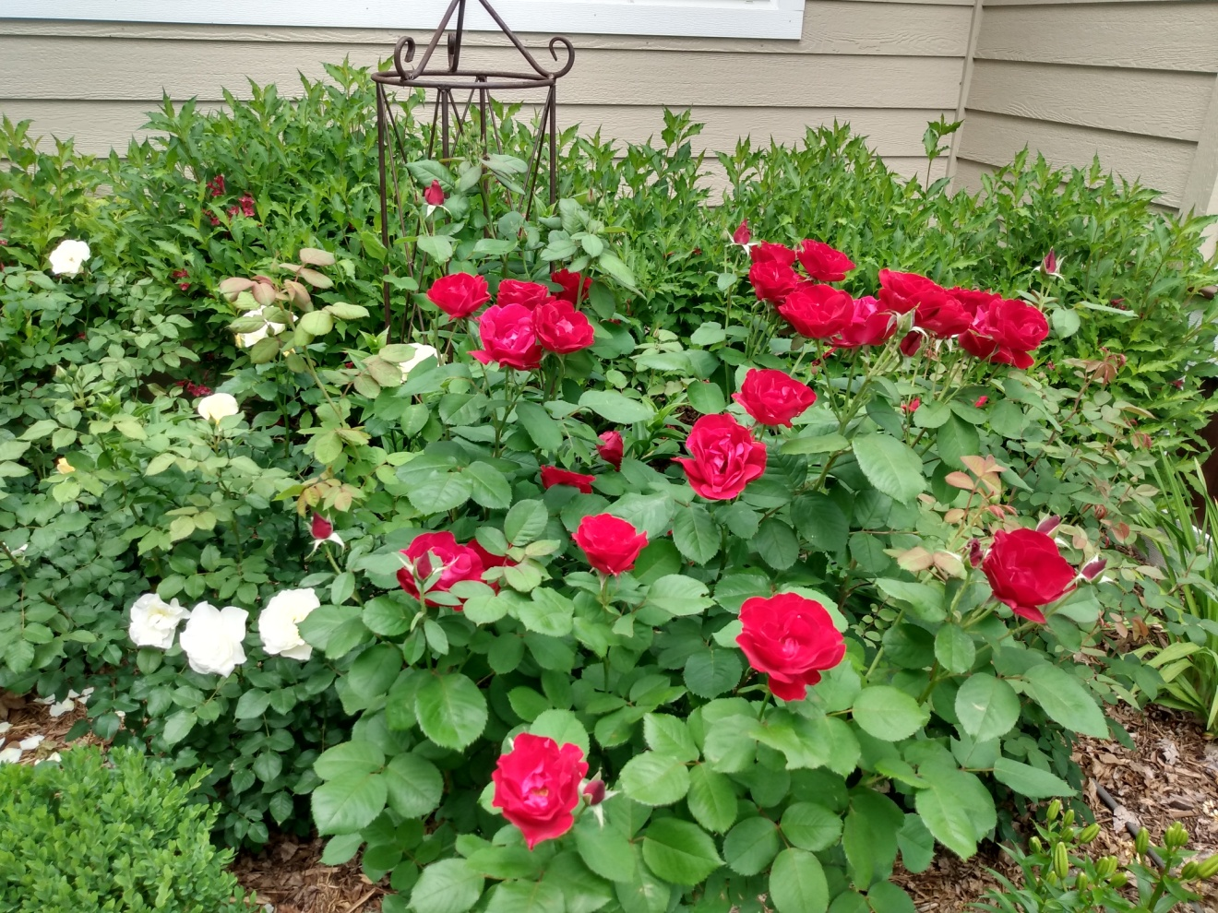
Emily Carr

Slide 4
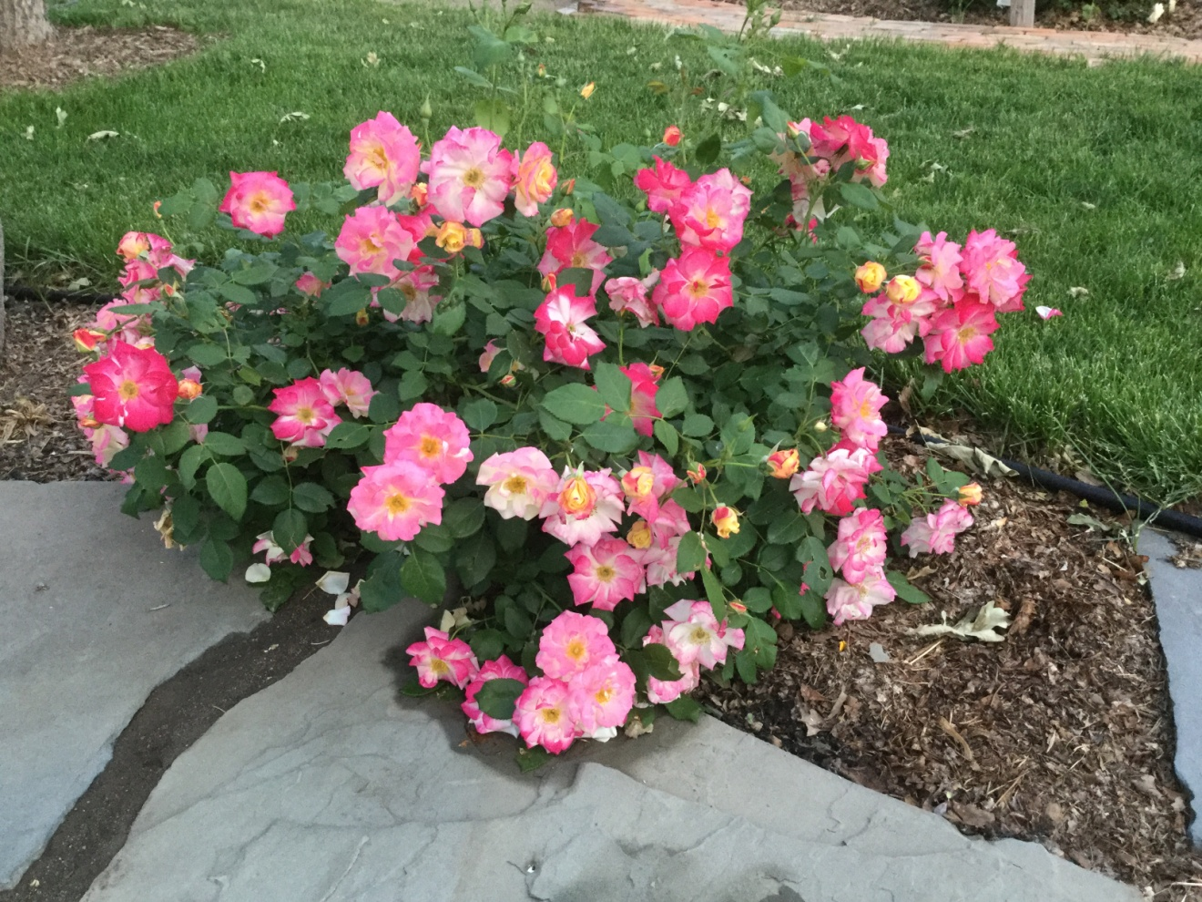
Campfire

Slide 5
Any issues?
Pests?
Leaf Cutter Bees
Budworms
Disease?
Blackspot
Powdery Mildew

Slide 6
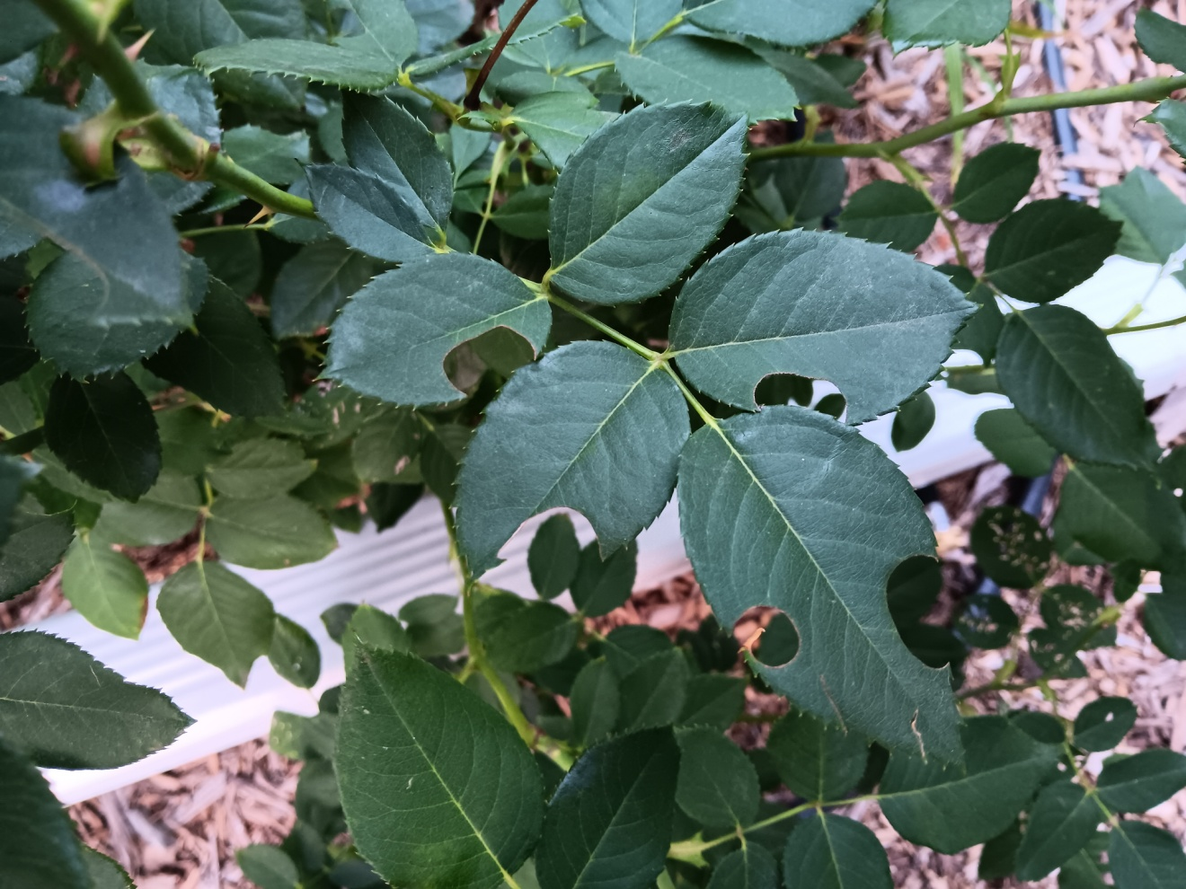
Leaf cutter bee damage.

Slide 7
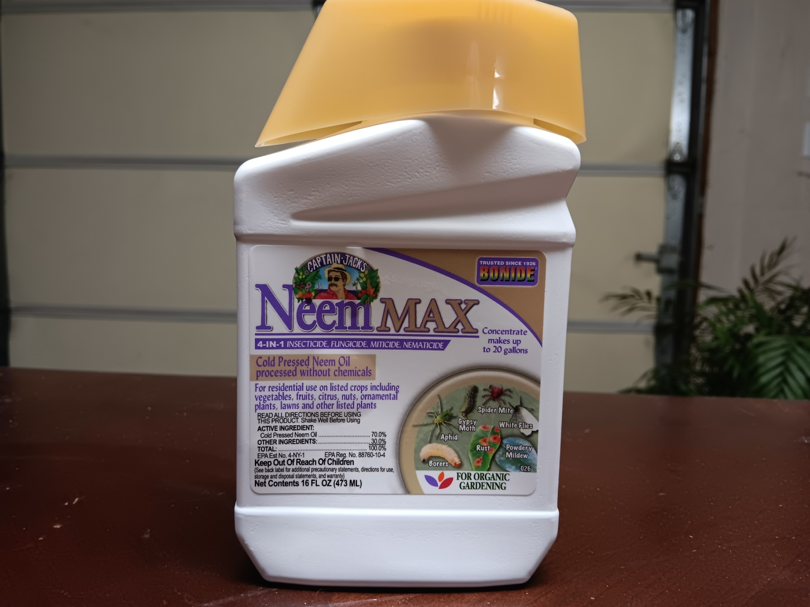
Meet your new best friend.

Slide 8
Winter Preparation
Winter preparation should start the end of August.
Do not fertilize.
Stop deadheading and pruning. Let the rose slow down and develop some hips.
Keep watering!

Slide 9
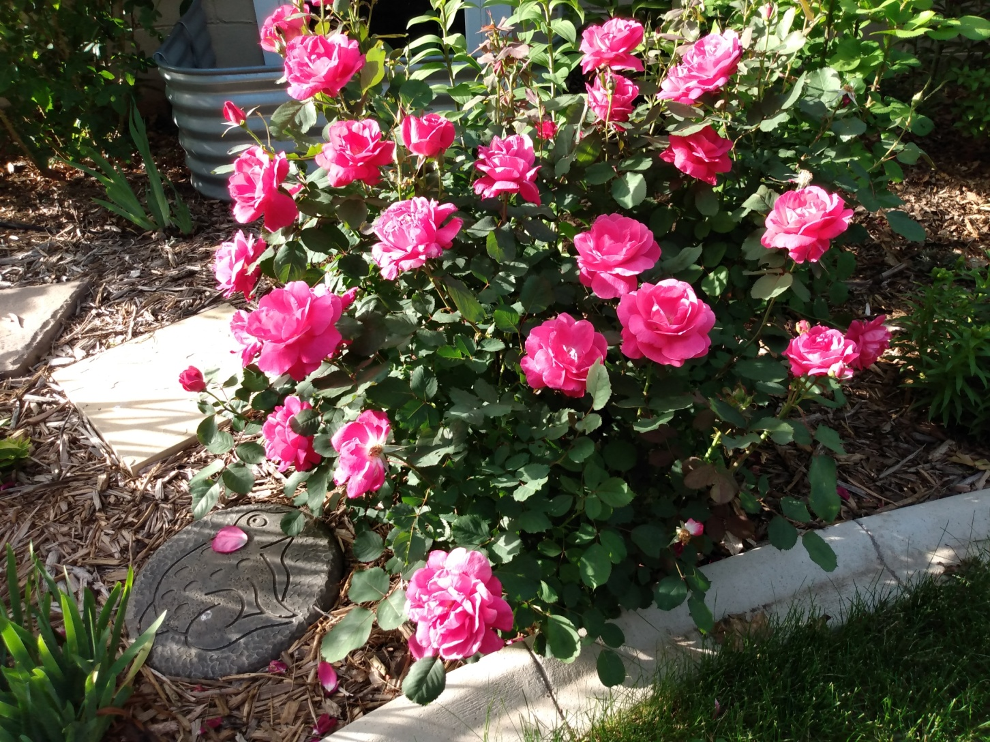
Even hardy roses can use some babying the first winter.

Slide 10
November is a good time for this.
You want the ground to be cold.
No rodent hotels!
You can pile leaves or mulch over the crown of the plant.
Pray for snow. It’s a great insulator.

Slide 11
Spring
When the weather starts to warm up pull the mulch (Or whatever you used for winter protection.) back from the crown of the plant.
“When the forsythia blooms it’s time to prune.”
Sharpen your bypass pruner and have something ready to disinfect them with.

Slide 12
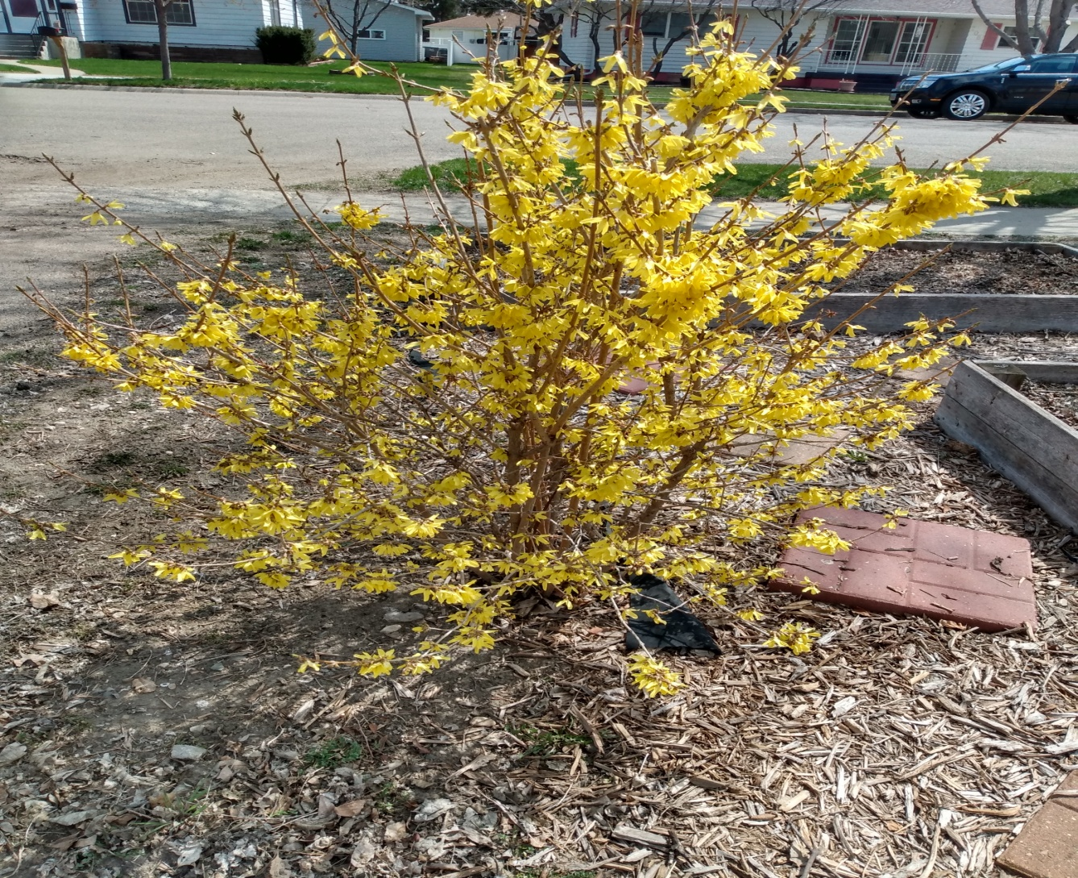
Forsythia

Slide 13
Spring Pruning
Pruning is equal parts art and science.
45 degree angle, ¼” above the bud.
Look for an outward facing bud.
Use a sharp pruner and disinfect between each rose.
Our hard winters will make most of the decisions for you.

Slide 14
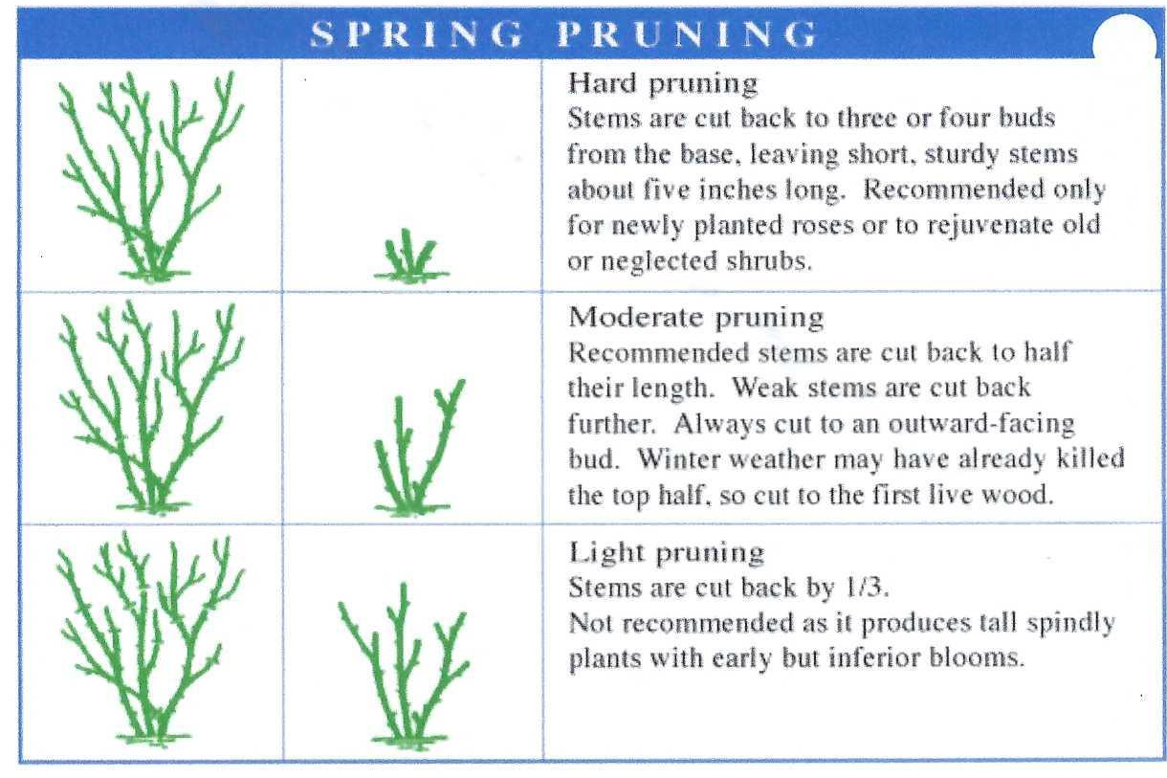

Slide 15
Don’t forget your ABC and D’s.
A for aesthetics.
B is for broken canes.
C is for crossing canes.
D is for dead, damaged and diseased canes.

Slide 16
The good part.
Expect to see rapid growth.
You may fertilize now and after the 1st flush of blooms.
Deadhead to keep the blooms coming.

Slide 17
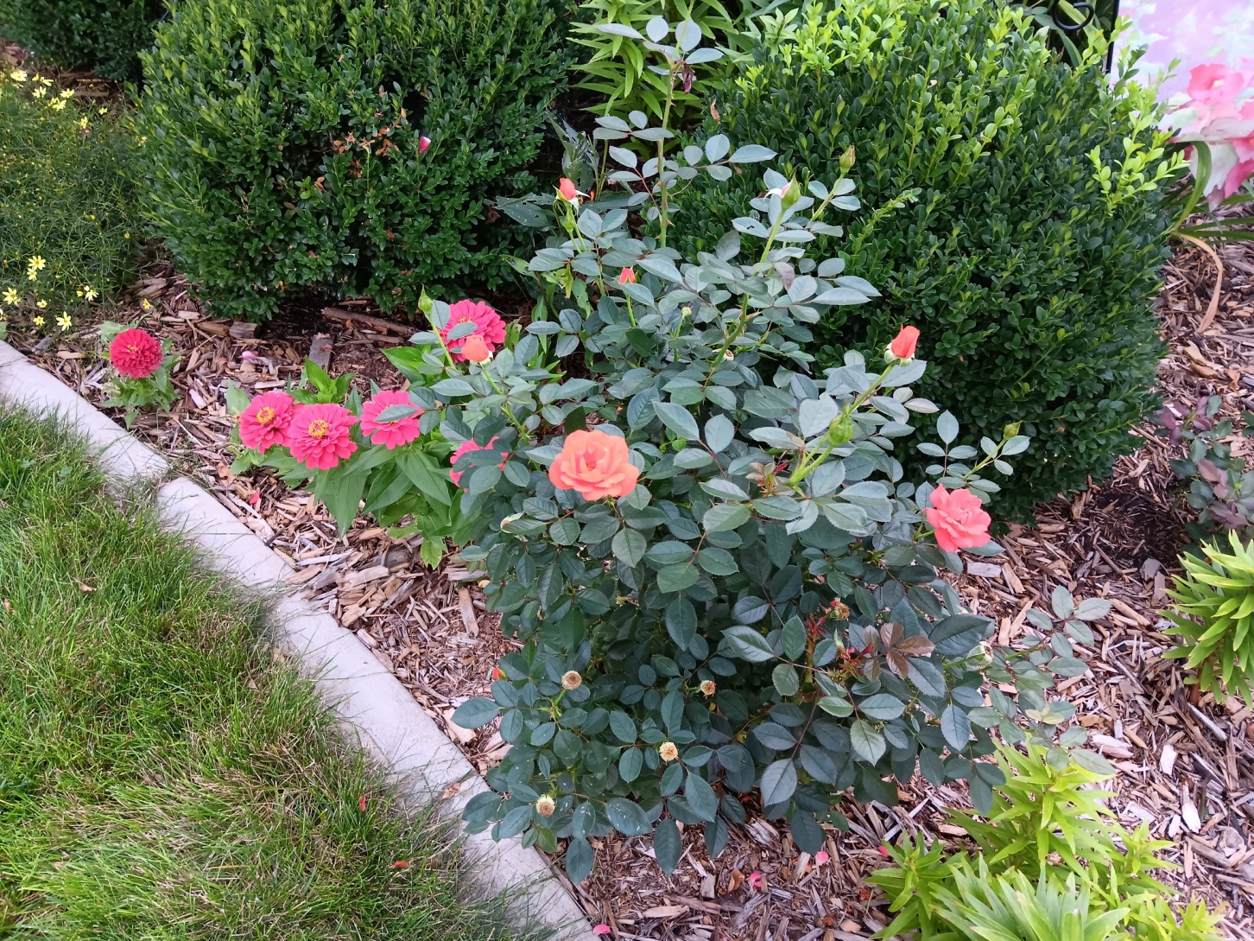
Enjoy

